Slide 1

Health Insure Fintech Solutions
End to End Health Insurance Management
- STRICTLY CONFIDENTIAL-

Slide 2
MEDVERVE CLAIM SOLUTION

Slide 3



Claim Solution
Turn Clinical and Operational Data into Evidence-Based Knowledge that you can Act On.

Slide 4
Claim Solution
[Modules]
Payer Contracting
Preauthorization
OP Claim Preparation
OP Claim Quality Check
OP Claim Submission
IP Claim Preparation
OP Claim Quality Check
IP Claim Submission
Payer Query Mail
Reconciliation
TDS Mapping
Denial/Short Paid Contest Recovery
Outstanding Management
Transactional Trial
Turn Around Time Measurement
MIS & Column Selection
BI Tools

Slide 5


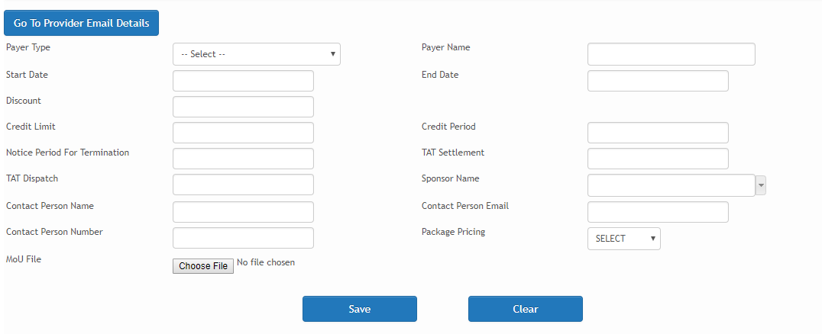
Payer Contracting
Payer Contracting helps in tracking mechanism for MOU Renewals
Provision for Capturing MOU/Agreed Tariff Details of Payers.
We systematically record the commencement and termination dates of agreements. This enables us to proactively generate reminder emails for the upcoming renewal of agreements, ensuring timely and seamless management of contractual obligations.
We systematically document both the credit limit and credit period negotiated between two entities. This encompasses the mutually agreed-upon monetary threshold and the specified time duration, fostering clarity and adherence to the agreed terms between the involved parties

Slide 6
Payer Contracting
The agreement includes a notice period, like three months, for termination between the parties involved.
TAT Dispatch refers to the Turnaround Time from claim submission to dispatch, measuring the duration it takes to process and send out a claim.
TAT Settlement stands for Turnaround Time for settlement, representing the duration it takes to process and complete the settlement
Historical/Existing data can also be uploded to understand the previous MIS, and also if there is any existing outstanding previous data can be carryforward
Historical data can be coded and stored in the platform
Co-pay guidelines can be captured and automated in the platform

Slide 7
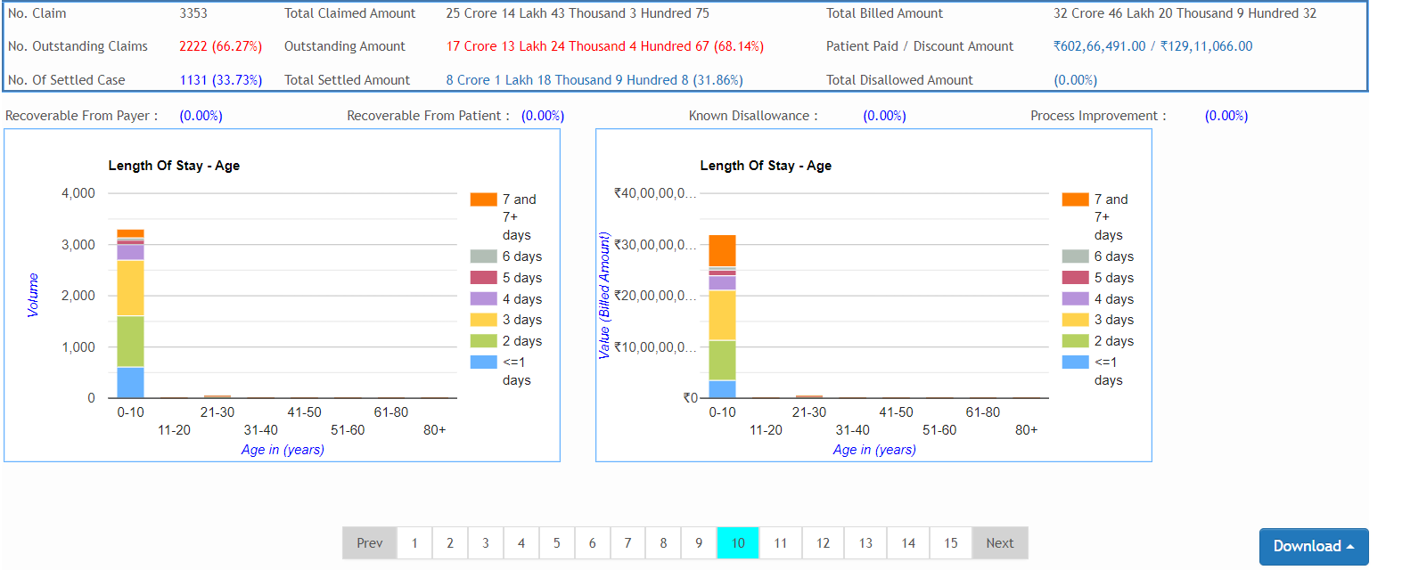
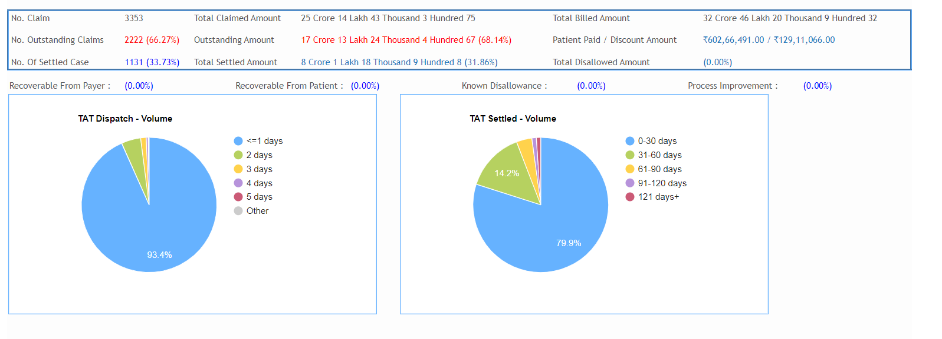
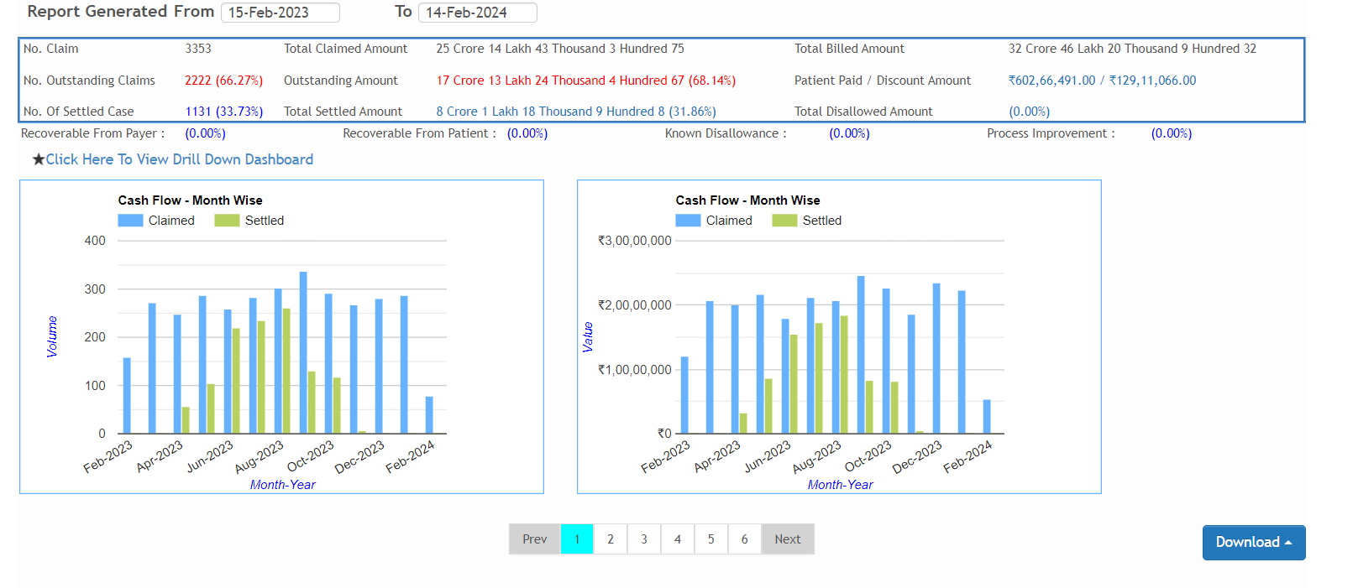
Payer Contracting
Platform enabled tracking mechanism with real-time graphical representation to understand deviations in Settlements and Dispatches as per agreed contractual obligations

Slide 8

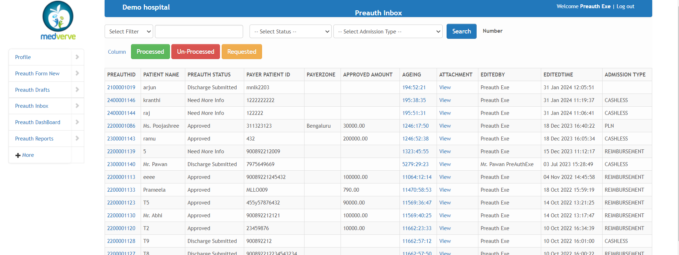
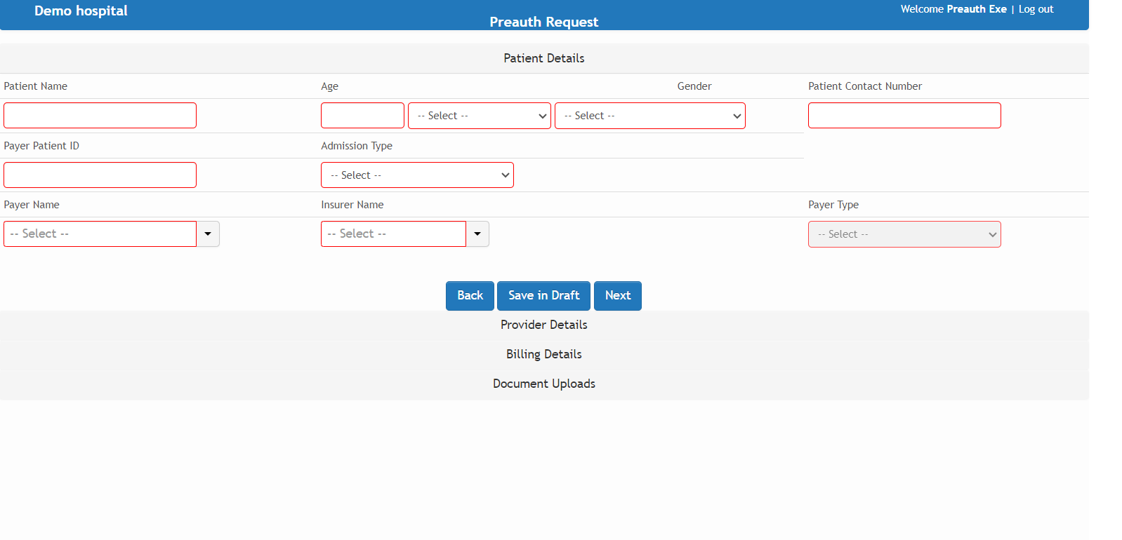

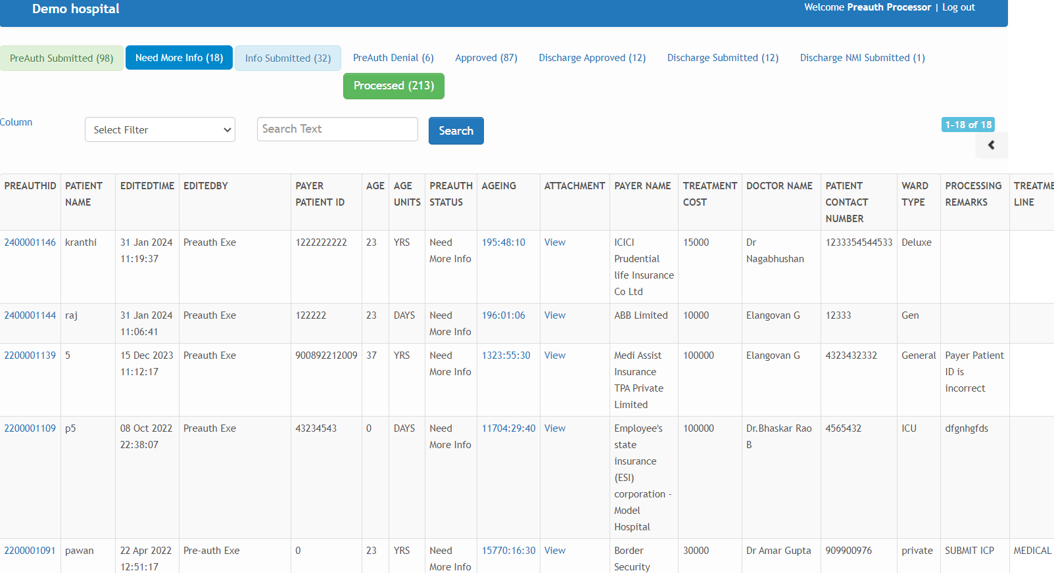
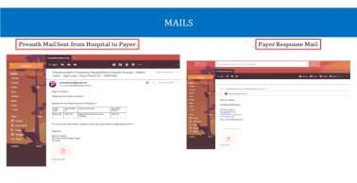
Preauthorization
A complete paperless solution to submit, manage and track preauthorization, enhancements and discharge requests with all TPA/Insurance companies and receive approvals with quickest turnaround time
PreAuth Enhancement
Scope to rework and re-present preauth and no possibility of missing out on required documents
Real time notifications from payer with integrated email tracking
Pre-authorization allows us to verify the authenticity of a patient, ensuring the validity of their information before proceeding with any transactions or services.

Slide 9

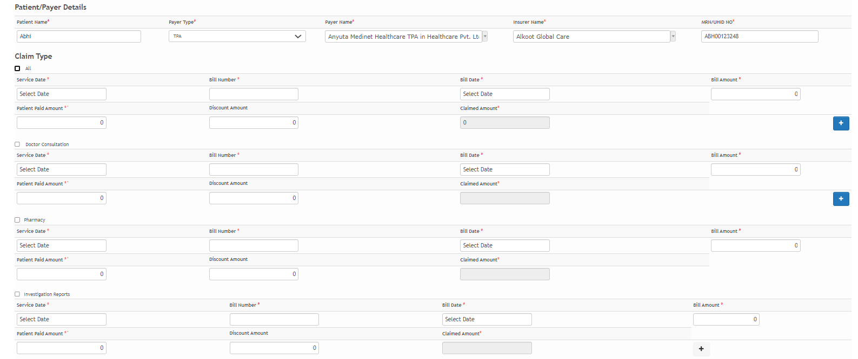
OP Claim Preparation
The captured information includes patient demographic details
Doctor Consultation
Pharmacy
Investigation Reports
Dental
Ophthalmology
Invoice/Claim Information
captured consists of
Pre defined payer package rates.
Patient Demographic details
Payer details.
Capture Co-pay, Total Bill, Claimed amount
Bill Details/Documents to
meet Payer Specific Format.

Slide 10

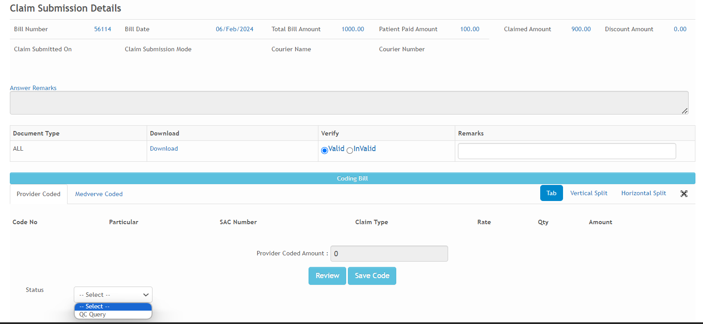
OP Claim Quality Check
The Outpatient (OP) claim quality check involves an Automated/Dynamic Checklist to ensure the submission of a comprehensive document set to the Payers.
Additionally, we can cross-check the split bill and medical coding to guarantee accuracy and completeness
Rule Engine configuration

Slide 11
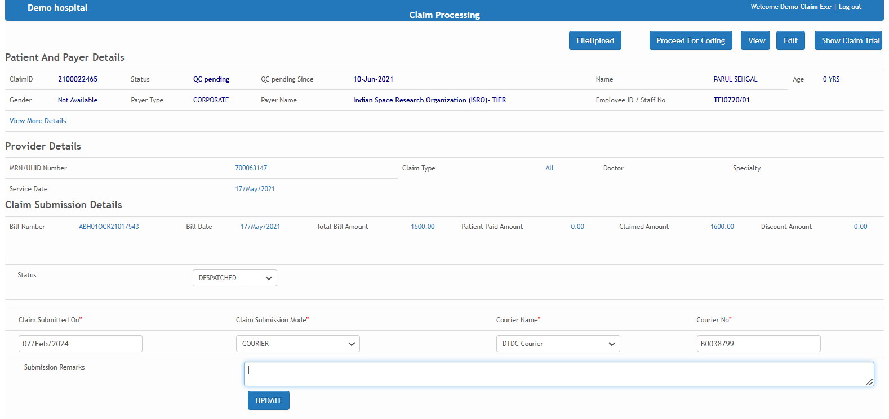
OP Claim Submission
RCM Solution enables tracking the movement of Claim/Invoice from visit till Submission of the Claim
All Modes of Submission are tracked with Time Stamping
Direct
Courer
Online
Tracking of claims are made easy and follow-up becomes more convenient

Slide 12
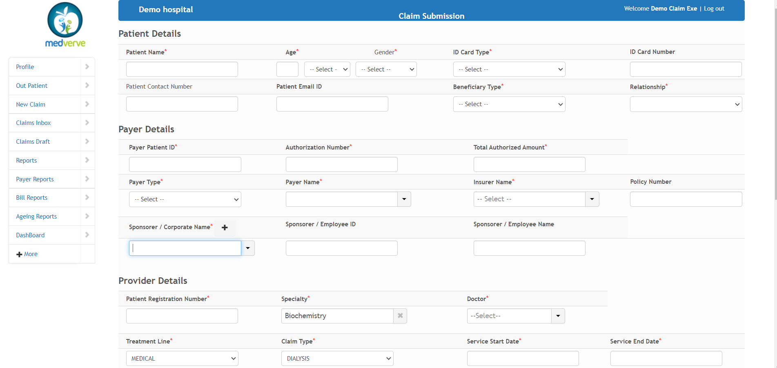
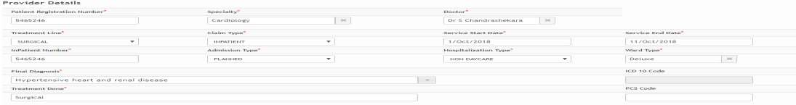
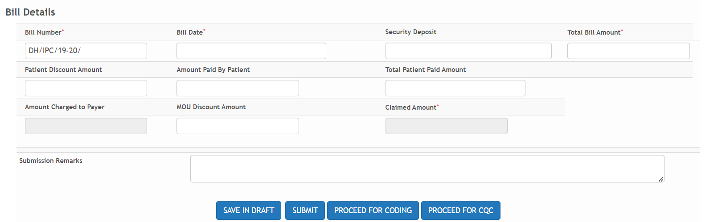
IP Claim Preparation
Post Discharge of the Patient, Invoice/Claim is captured and achieved in the Platform.
Minimal need for training of staff due to user-friendly interface
Capture Co-pay, Total Bill, Claimed amount
Invoice/Claim Information
captured consists of
Patient Demographic details
Payer details
Provider details
Bill Details/Documents to
meet Payer Specific Format

Slide 13
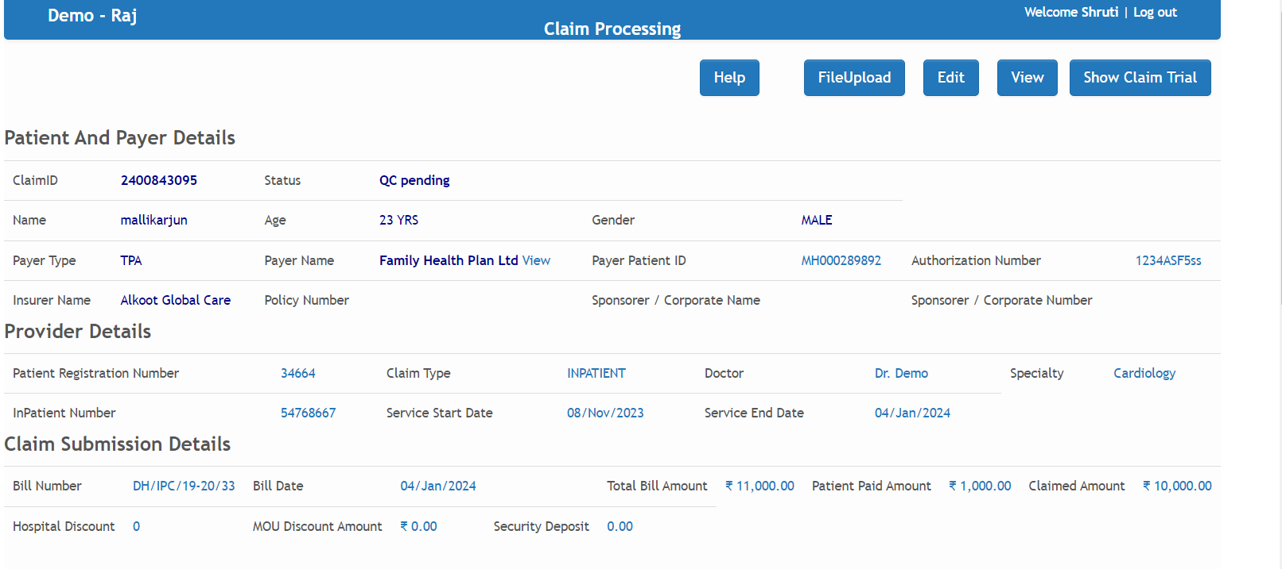
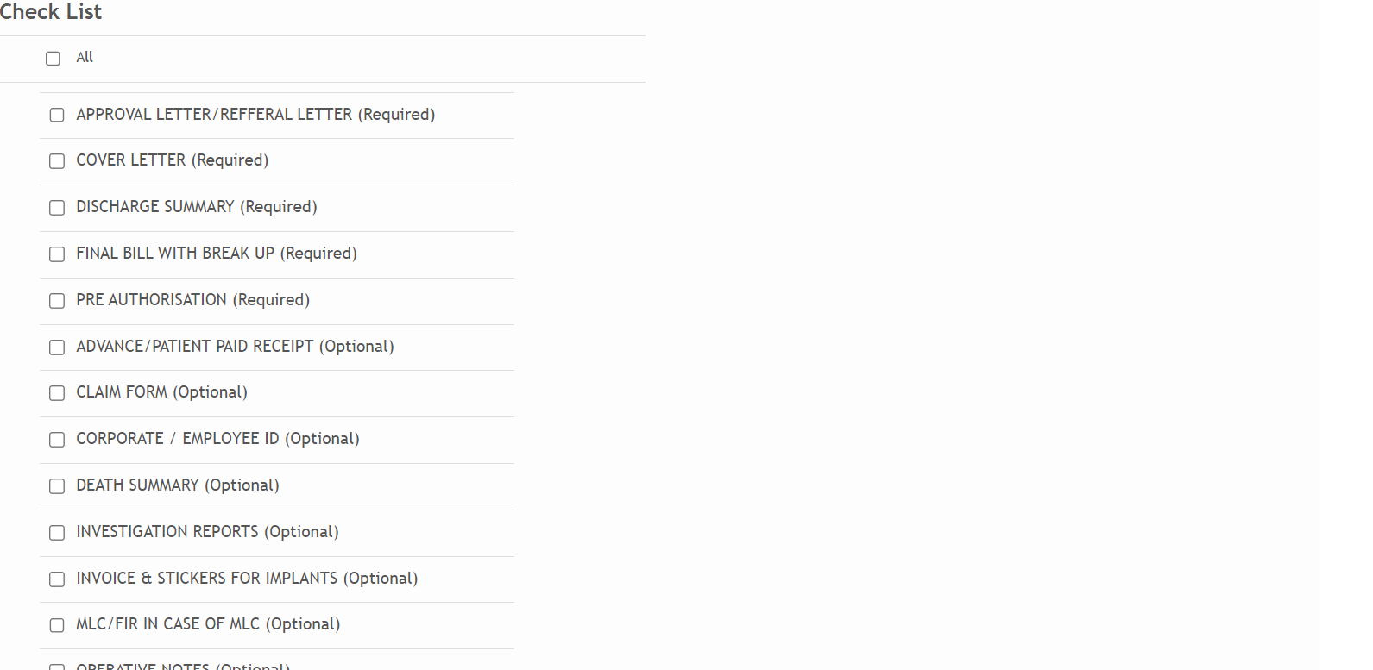
IP Claim Quality Check
Automated/Dynamic Check List ensures the complete set of documents are submitted to the Payers.
No possibility of missing out on required documents
Claim Enhancement
Ensures error-free, complete
submissions
After completing the Claim Quality Check (CQC), A QC report is generated and an automated mail is triggered to the hospital management.
An automated pre-dispatch tracker mail is triggered to the management for efficient handling.

Slide 14
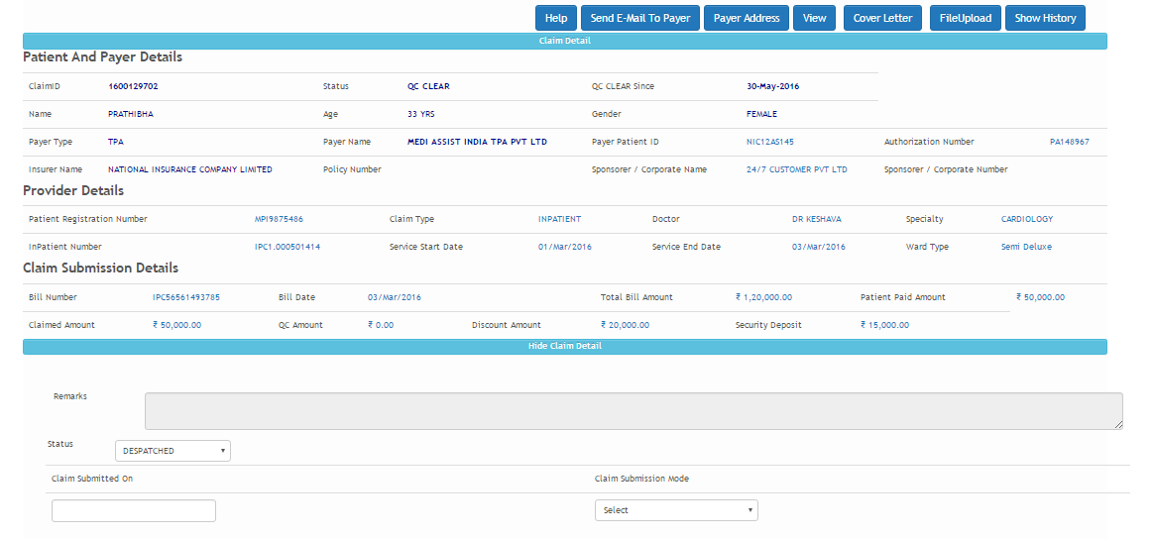


IP Claim Submission
RCM Solution enables tracking the movement of Claim/Invoice from Discharge till Submission of the Claim
All Modes of Submission are tracked with Time Stamping
Direct
Courer
Online
Tracking of claims are made easy and follow-up becomes more convenient

Slide 15

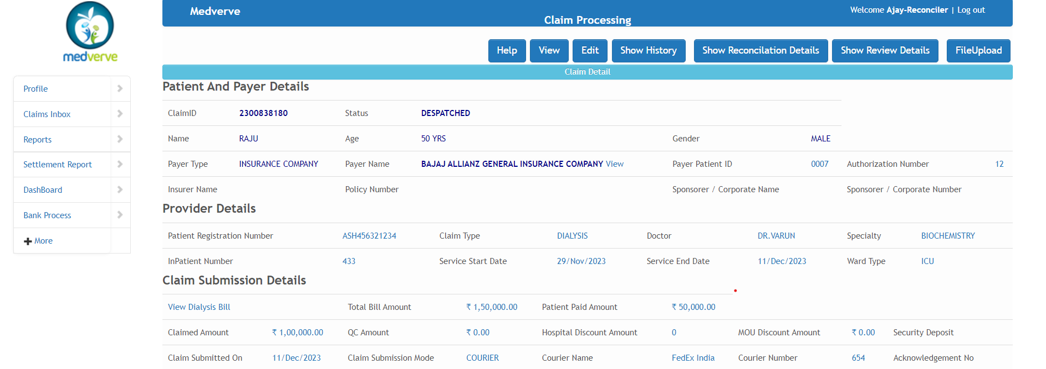
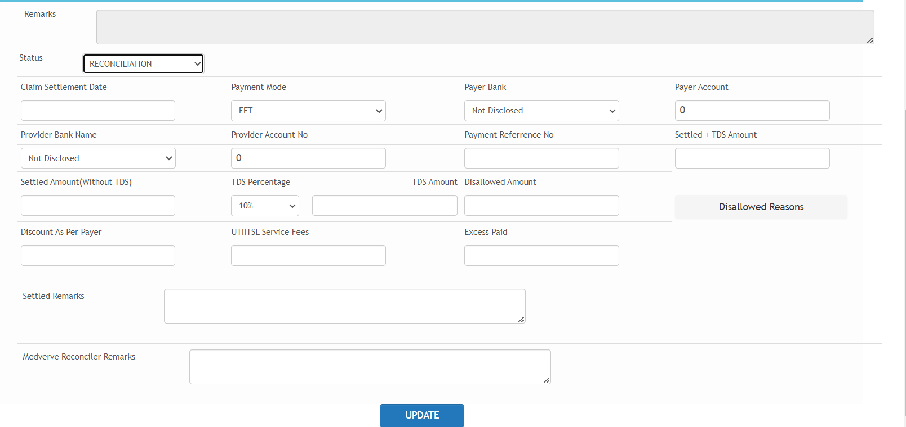
Payer Reconciliation
Reconciliation to intelligently match payment data from the payer with the amounts and information to confirm payments are accurate and notify outstanding charges.
Data scraping from Payer portal and Mailbox.
We reconcile all the payments, leaving with more time to manage business- critical initiatives.
Settlement Letter from Payer along with Claim Settlement Date, Payment Mode, Payment Reference Number, Settled Amount, TDS Amount and Net Amount are captured.
Time Savings and Error elimination

Slide 16
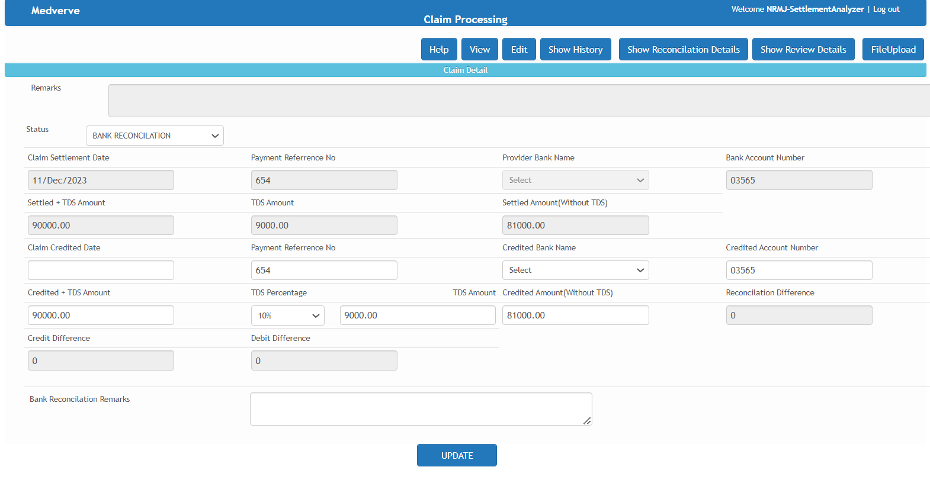
Bank Reconciliation
Process of comparing and matching the Hospital/Clinic's bank statement with settlements reports.
Hospital/Clinic can effectively ensure the accuracy of their financial records
Settlement Letter from Payer along with Claim Settlement Date, Payment Mode, Payment Reference Number, Settled Amount, TDS Amount and Net Amount are captured.
Time Savings and Error elimination

Slide 17
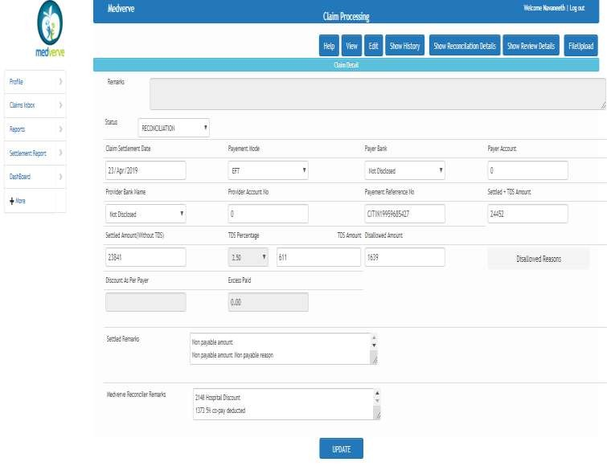
Payer Reconciliation
24/7 Automated reconciliation to intelligently match payment data from the payer with the amounts and information to confirm payments are accurate and notify outstanding charges.
Automatic Data scraping from Payer portal and Mailbox.
Our system automatically (BOTS) reconcile all the payments, leaving with more time to manage business- critical initiatives.
Settlement Letter from Payer along with Claim Settlement Date, Payment Mode, Payment Reference Number, Settled Amount, TDS Amount and Net Amount are captured.
Time Savings and Error elimination

Slide 18
Bank Reconciliation
24/7 Automated reconciliation to intelligently match payment data from the payer with the amounts and information to confirm payments are accurate and notify outstanding charges.
Our system automatically (BOTS) reconcile all the payments, leaving with more time to manage business- critical initiatives.
Settlement Letter from Payer along with Claim Settlement Date, Payment Mode, Payment Reference Number, Settled Amount, TDS Amount and Net Amount are captured.
Time Savings and Error elimination

Slide 19


Payer Query Mail
Communication to hospital/Clinic team regarding query raised by payer post submission of claim
Payer Query Mail , an automated mail is generated and triggered to notify the hospital/Clinic and address the query promptly."
Trigger point in portal, 7 days alert mail for claim submission.
connect@medverve.com
To hospital@gmail.com CC provider@gmail.com
SNo. | Claim MVID | Patient Nam | Bill Number | Authoriza | Payer Type | Payer Name | Claim Status | Claimed A | Payer Remarks
1 | 1900409284 | JUI SACHIN J | ABH01ICR190 | 4448801 | TPA | Paramount H | QUERY RAISE | ₹ 1,42,403 | Bronchoscopy with bal:Reports for Investigations mentioned in final bill
2 | 1900469285 | Danish | ABH01ICR190 | 2148802 | TPA | Medi Assist | QUERY RAISE | ₹ 3,20,500 | Investigation Report Missing

Slide 20
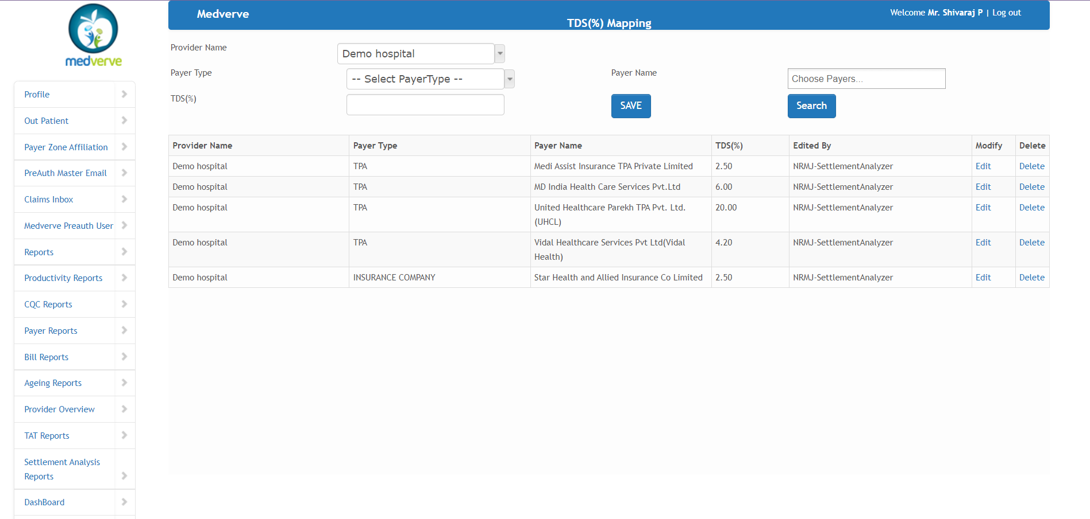
TDS Mapping
TDS Calculation as per agreed %
Specific to Provider and Payer
The payer issues specific TDS (Tax Deducted at Source) to the provider based on the agreed percentage,
Specific to Payer and Hospital TDS % is mapped and set default.

Slide 21

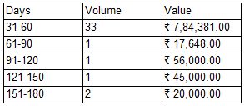
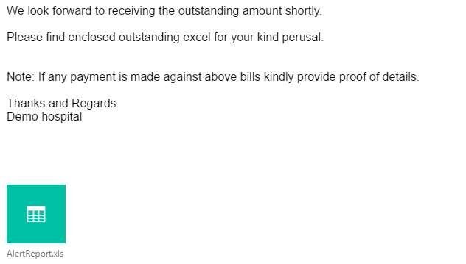
Outstanding Management
Managing Payer Outstanding by repeated alerts to the respective Payers regarding Overdue Payments.
Dunning Letter to Payers as follow up process for Outstanding Payments at pre-defined Intervals.
Real Time status of receivables and ageing analysis on click of button at amazing speed increases the efficiency in managing the outstanding
It becomes easy to follow-up on outstanding payments, and saves hundreds of accounting hours

Slide 22
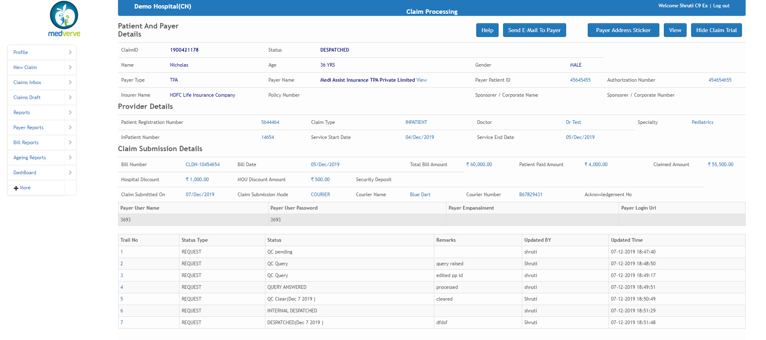
Transactional Trial
Helps in tracking the entire claim journey with accurate details at any stage of claim
Provides objective, trusted evidence for the existence of data at any given time.
Zero data manipulation
Inputs and modifications are logged and the authors noted

Slide 23
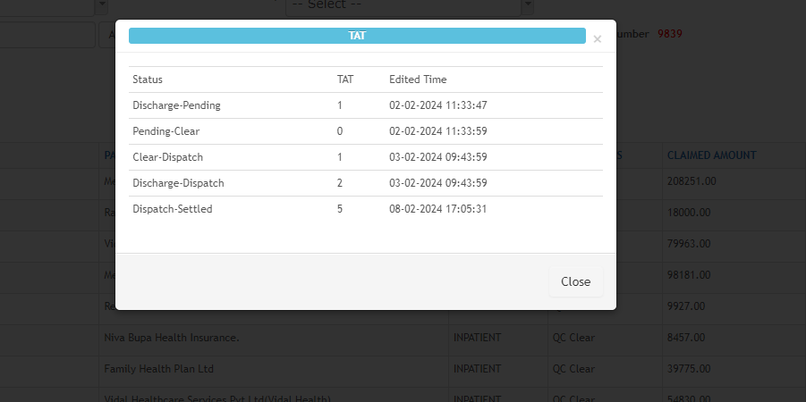
Turn Around Time
Real-time calculation of Turn Around Time for all the status helps in understanding the trace of claims.
Turn Around Time (TAT) calculation in real-time for all status, gives us a clear understanding of how claims are progressing, improving our insight into their journey and processing efficiency

Slide 24
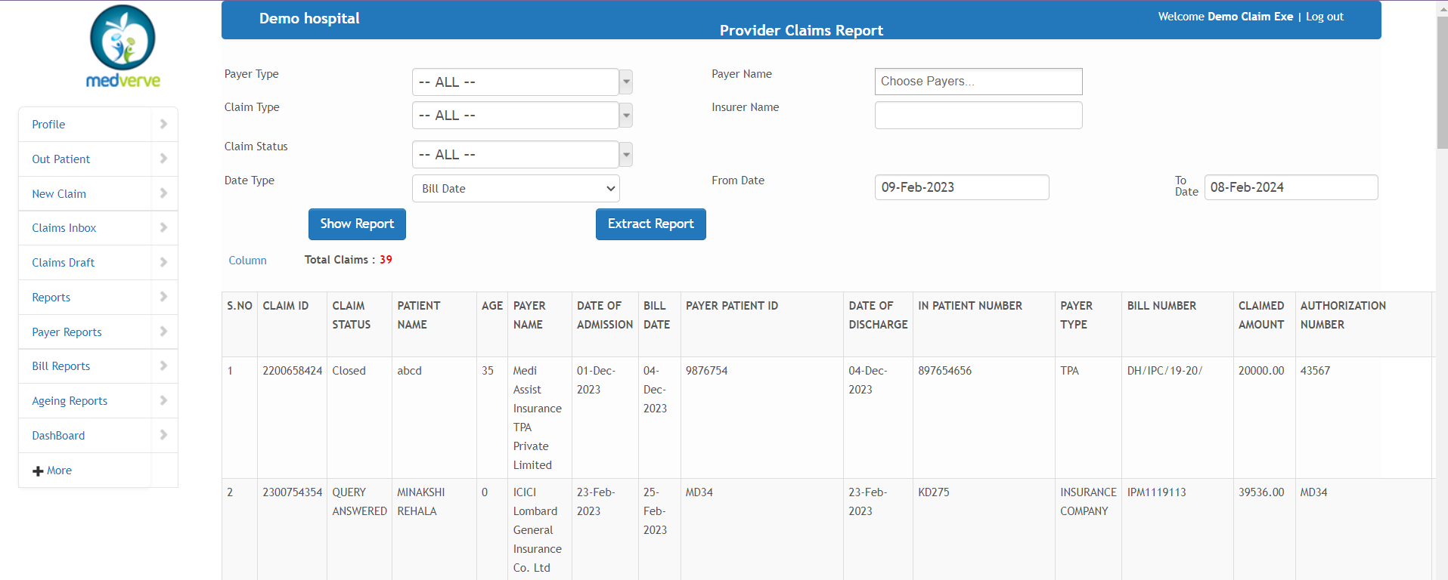
MIS
Computerized database of financial information organized and programmed to produce regular reports.
Collection and Outstanding Ageing –
Bill wise reports
Bill wise TAT calculation of Submission and Payment
Countless combinations to generate numerous kinds of reports with column selections
Dedicated section for Claims reports, Payer reports, Ageing reports and Bill reports.

Slide 25

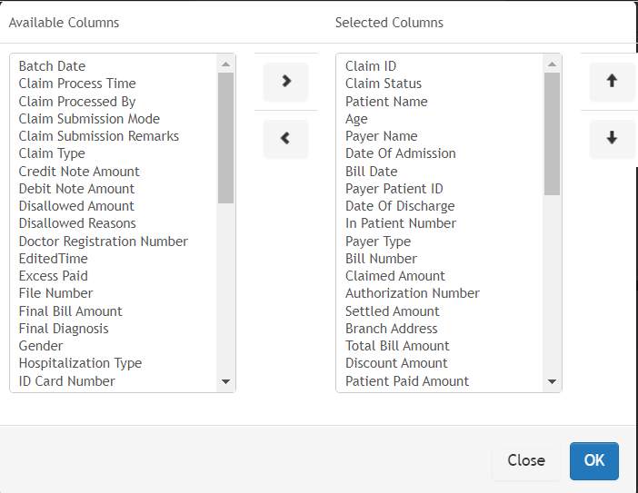
Column Selection
User can choose the desired columns
Multiple reports can be extracted as per the column selection
Line items could be aligned as per the
convenience

Slide 26

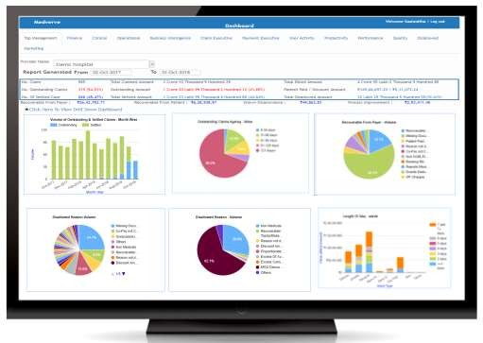
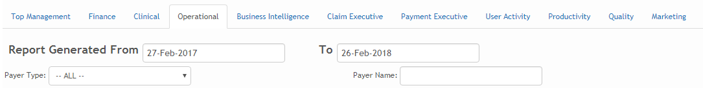
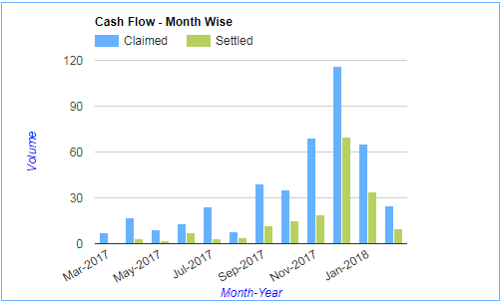
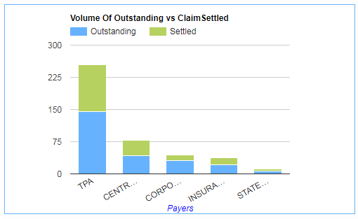
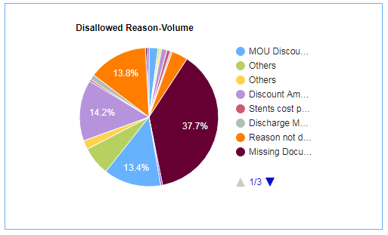
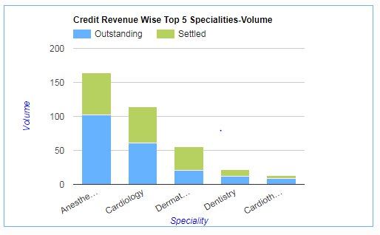
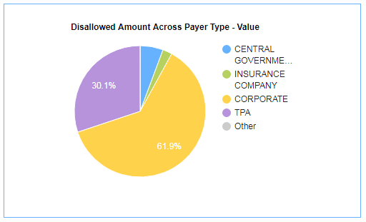
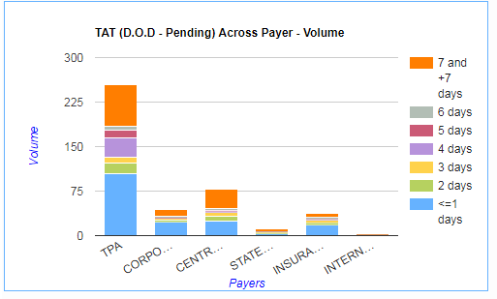
BI Tools
Specifically designed to combine multiple data sources and find correlations necessary to make critical healthcare decisions.
Summarizes and visualizes important data which need immediate attention
Shows organizational and departmental performance which can be drilled down further to any KPI to get more information.
Data could be converted as PPT and PDF
Cash flow
Top Management and Financial Dashboards
Outstanding and Settlement Ageing
Disallowance Dashboards
Payer wise Outstanding and Settlement
Clinical Dashboards
Operational Dashboards
Marketing Dashboards
Business Intelligence Dashboards
Productivity Dashboards

Slide 27
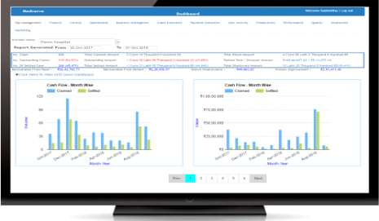
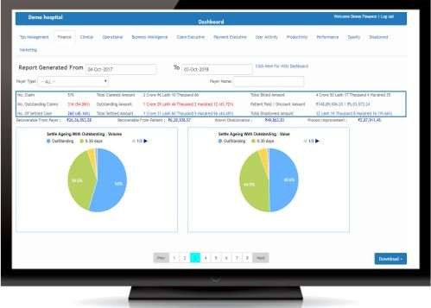
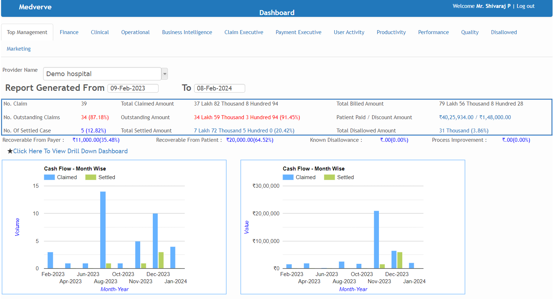
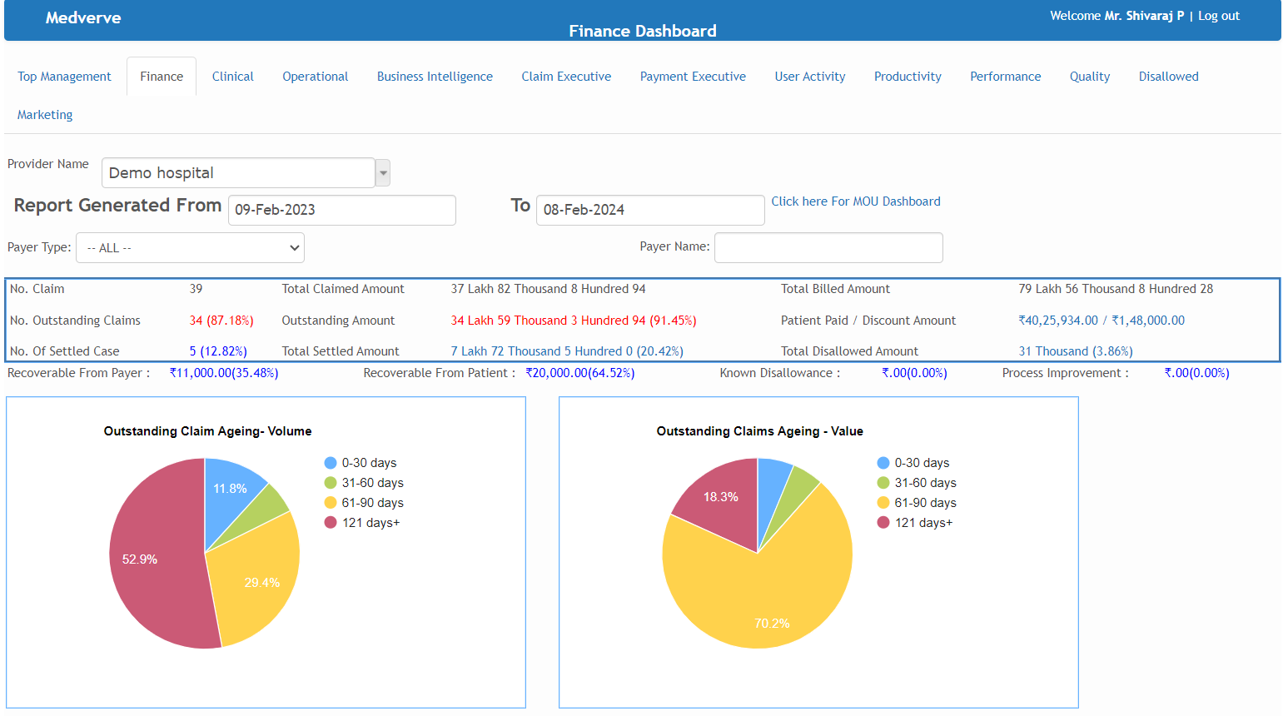
BI Tools
Top Management Dashboard
Finance Dashboard

Slide 28
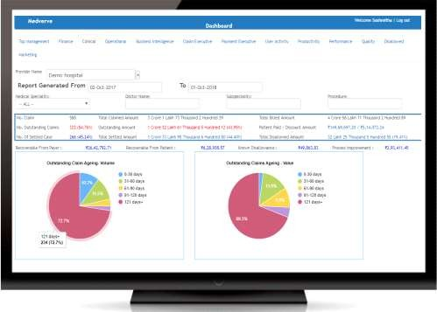
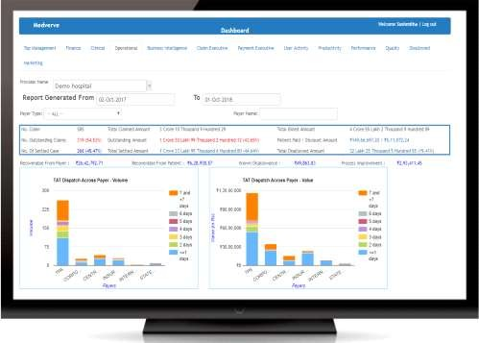
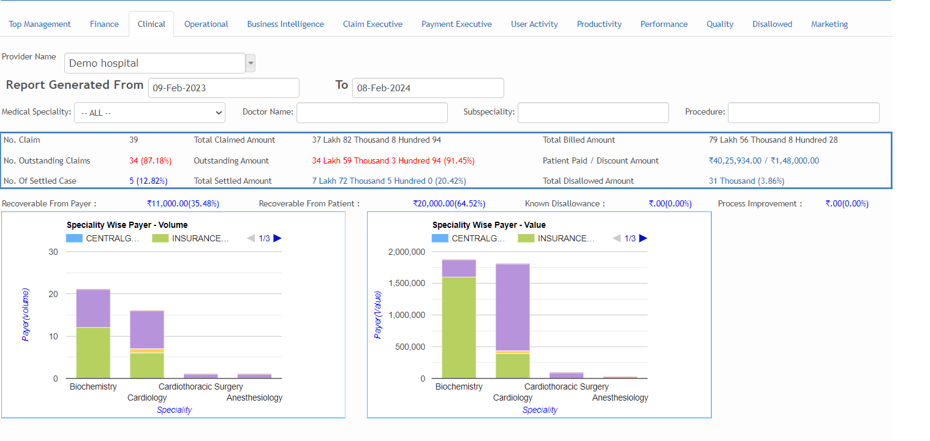
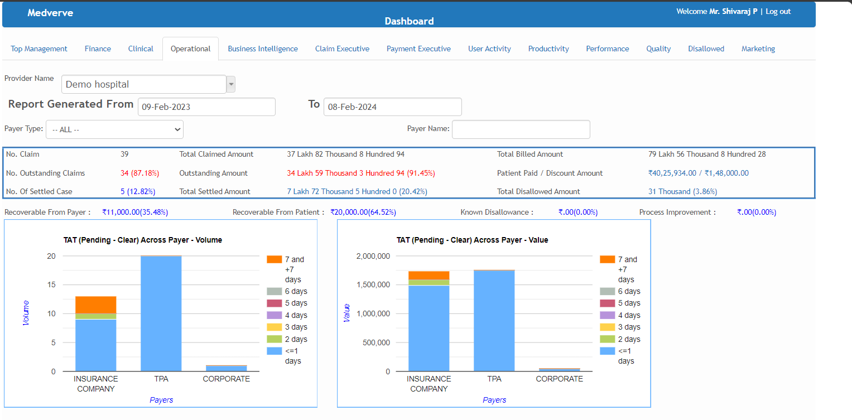
BI Tools
Clinical Dashboard
Operational Dashboard

Slide 29
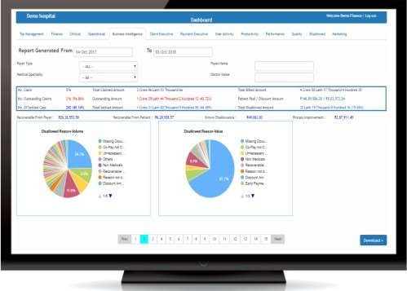
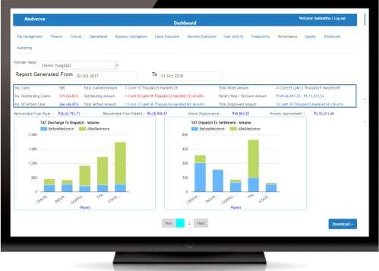
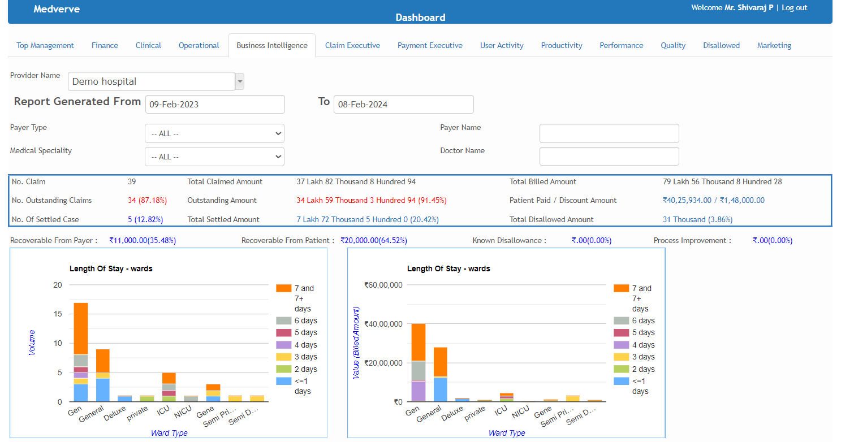
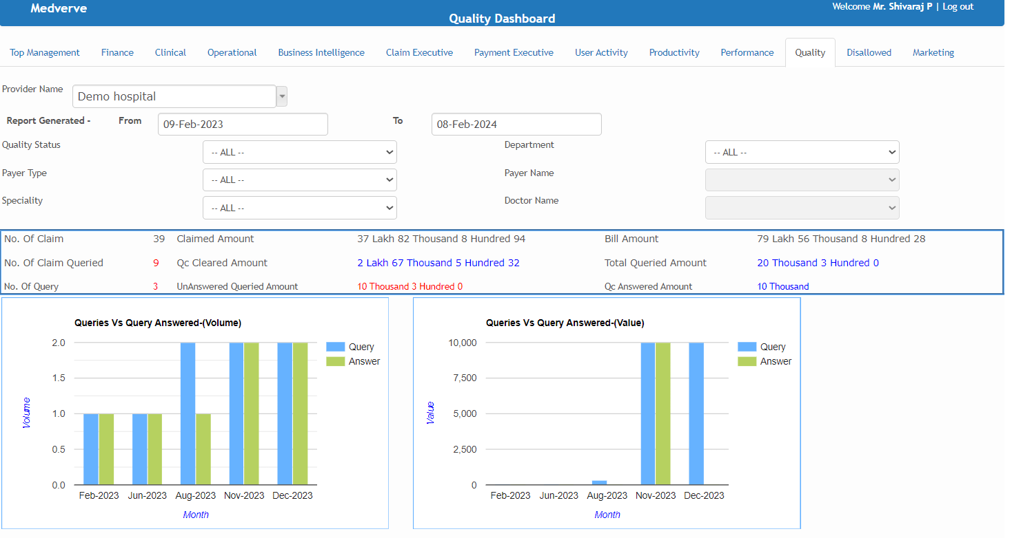
BI Tools
Business Intelligence Dashboard
Performance Dashboard

Slide 30
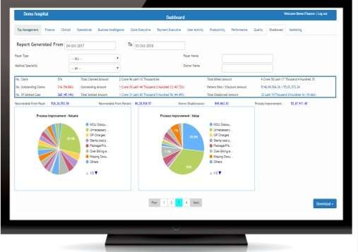
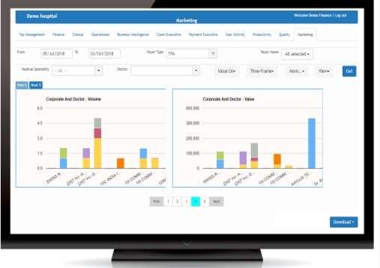

BI Tools
Disallowance Dashboard
Marketing Dashboard

Slide 31


Thank You
Contact - info@medverve.com

